Slide 1
CONTROLLING

Slide 2
CONTROLLING
The process of measuring progress toward planned performance and, if necessary, applying corrective measures to ensure that performance is on the line with manager’s objectives.

Slide 3
CONTROLLING PROCESS
Setting performance standards
Measuring actual performance
Comparing performance with the standard vs. actual, and determining deviations
Remedying unfavorable deviation by taking corrective action

Slide 4
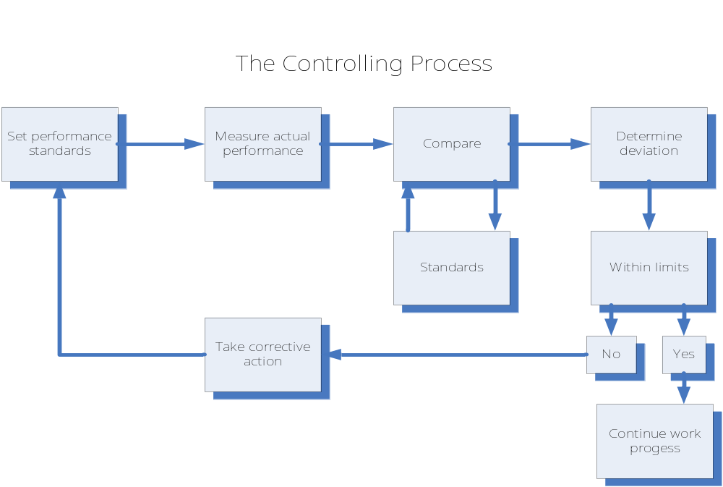
CONTROLLING PROCESS

Slide 5
ESTABLISHMENT OF STANDARDS
Standards are simply criteria of performance.
They are selected points in an entire planning program, at which measures of performance are made so that managers can receive signals about how things are going and thus, do not have to watch every step in the execution of plans.

Slide 6
MEASUREMENT OF PERFORMANCE
If standards are clearly & objectively established and made known to the performer of a job, then measurement of performance becomes easy.
The most common means of measurement are: personal observations, use of statistical data and reports, both oral and written.

Slide 7
CORRECTION OF DEVIATIONS
Managers may correct deviations by:
  Redrawing their plans or modifying their goals;
  Exercising their organizing function through reassignment or clarification of duties;
  Additional staffing;
  Better selection and training of subordinates;
  Ultimate re-staffing measure—firing;
  Better leading—fuller explanation of the job or more effective leadership techniques.

Slide 8
TYPES OF CRITICAL POINT STANDARDS
Physical Standards
  Nonmonetary measurements and are common at the operating level, where materials are used, labor is employed, services are rendered, and goods are produced.
  May reflect quantities, or qualities; such as labor-hours per unit of output and fastness of a color, respectively.

Slide 9
TYPES OF CRITICAL POINT STANDARDS
Cost Standards
  Monetary values & measurements and, like physical standards, are common at the operating level.
  Illustrative of cost standards widely used are: direct and indirect costs per unit produced and labor cost per unit or per hour. ( $5/#; Php380/day; etc…)

Slide 10
TYPES OF CRITICAL POINT STANDARDS
Capital Standards
  Application of monetary measurements to physical items.
  Have to do with the capital invested in the firm rather than with operating costs, and are therefore primarily related to the balance sheet rather than to the income statement.

Slide 11
TYPES OF CRITICAL POINT STANDARDS
Revenue Standards
  Arise from attaching monetary values from sales.
  May include such standards as revenue per bus passenger-mile, average sales per customer, and sales per capita in a given market area.

Slide 12
TYPES OF CRITICAL POINT STANDARDS
Program Standards
  A manager may be assigned to install a variable budget program, a program for formally following the development of new products, or a program improving the quality of a sales force.
  Although some subjective judgment may have to be applied in appraising program performance, timing and other factors can be used as objective standards.

Slide 13
TYPES OF CONTROL
Preliminary Control (sometimes called feed forward control) – takes place before operations begin and includes policies, procedures, and rules designed to ensure that planned activities are carried out properly.
Ex. Inspection of raw materials, proper selection and training of employees

Slide 14
TYPES OF CONTROL
Concurrent Control – takes place while plans are being carried out.
Ex. directing, monitoring
Feedback Control – focuses on the use of information about results to correct deviations from the acceptable standard after they arise.
Multiple Approaches Control

Slide 15
MANAGEMENT AUDITS
They are means for evaluating the effectiveness and efficiency of various systems within the organization, from social responsibility to accounting control.

Slide 16
TYPES OF AUDITS
External Audits – occurs when one organization evaluates another organization; used in feedback control in the discovery and investigation of the savings and loan scandals.
Internal Audits – improve the planning process and the organization’s internal control systems; essential functions include periodic assessment of a company’s own planning, organizing, leading, and controlling.

Slide 17
BUDGETING
Budgeting (or budgetary control) – the process of finding out what’s being done and comparing the results with corresponding budget data to verify accomplishments or to remedy differences.

Slide 18
TYPES OF BUDGET
Sales Budget
  Usually data for the sales budget that are prepared by month, sale area, and product.
Production Budget
  Commonly expressed in physical units, required information include types and capacities of machines, economic quantities to produce, and availability of materials.
Cost Production Budget
  Information is sometimes included in production budgets, comparing production cost with sales price shows whether or not profit margins are adequate.

Slide 19
TYPES OF BUDGET
Cash Budget
  Prepared after all other budget estimates are completed, shows the anticipated receipts and expenditures, the amount of working capital available, the extent to which outside financing may be required, and the periods and amounts of cash available.
Master Budget
  Includes all major activities of the business, brings together and coordinates all the activities of the other budgets and can be thought of as a “budget of budgets”.

Slide 20
COMPARATIVE BALANCE SHEETS
It shows the financial picture of a company at a given time. Itemizes 3 elements:
  Assets – values of the various items the corporation owns.
  Liabilities – amounts the corporation owes to various creditors.
  Stockholder’s Equity – amount accruing to the corporation’s owners.
Balance Sheet Equation:
  Assets = Liabilities + Stockholder’s Equity
Profit and Loss Statement
  An itemized financial statement of the income and expenses of the company’s operations during the accounting period.

Slide 21
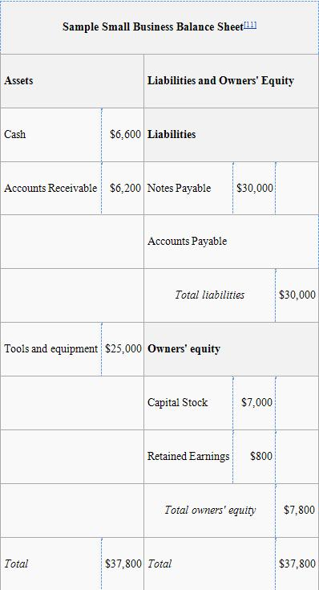
BALANCE SHEET – AN EXAMPLE

Slide 22
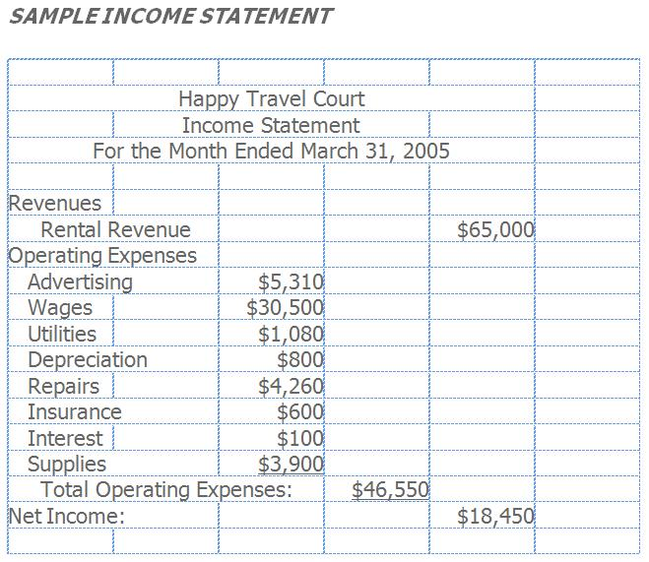
INCOME STATEMENT – AN EXAMPLE

Slide 23
CHARACTERISTICS OF AN
EFFECTIVE CONTROL SYSTEM
Valid Performance Standards
  Standards should be expressed in quantitative terms, should be objective rather than subjective.
Adequate Information to Employees
  Information should be accessible as possible, particularly when people must make decisions quickly and frequently.
Acceptability to Employees
  Control systems should emphasize positive behavior rather than trying to control negative behavior alone.

